Slide 1
Competitive Cyber Security Organization
Stego + Forensics
By attending today’s meeting you acknowledge that you may be photographed or recorded for club use

Slide 2
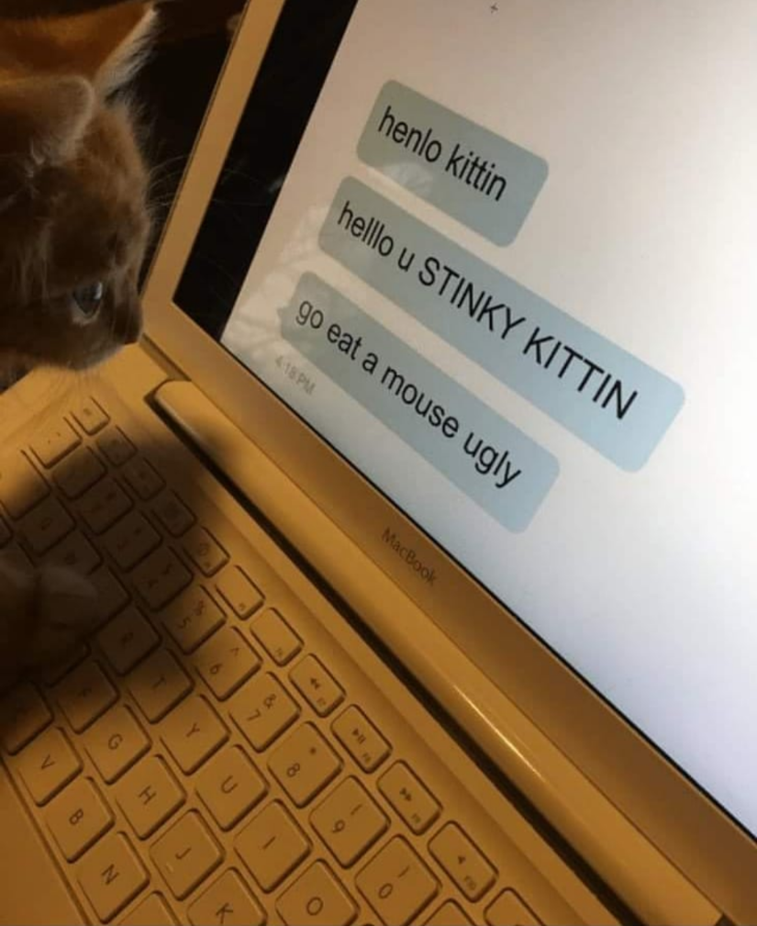
Learning Objectives:
What is Forensics?
Different types of forensics
Who uses Forensics?
Real world applications of forensics
Try out some forensic techniques

Slide 3
Forensics
Investigating digital content and media
Different types
Network
Disk (Files, etc.)
Memory
Malware
Mobile

Slide 4
Practical Applications
Incident Response
Finding root cause
Log analysis; understanding what happened
Recovering lost data
Understanding network traffic
Law enforcement

Slide 5
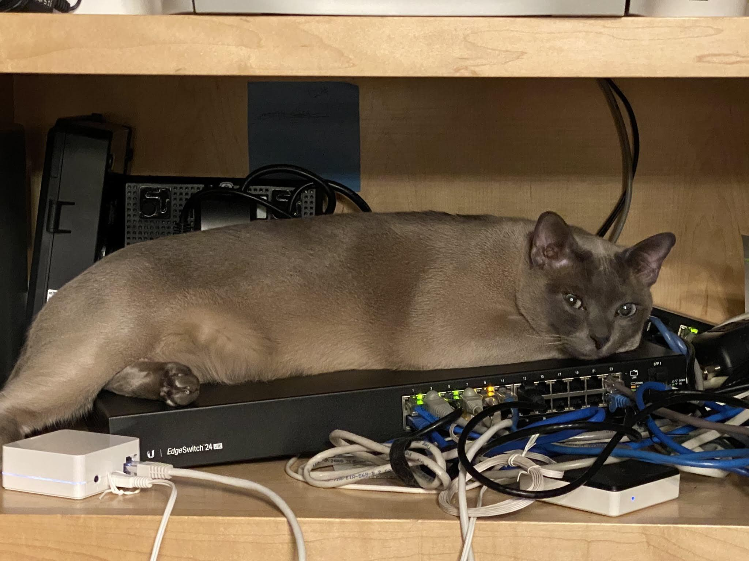
Network Forensics
Diving deep into network traffic
Analyzing host behavior
Requires an in depth understanding of a network
Packet analysis
Wireshark, networkminer, etc.

Slide 6

Disk Forensics
Deriving information from digital media
Filesystem, or physical (ex. HDD recovery)
Recovery of deleted or encrypted information
Disk Images - FTK, Autopsy, etc.
Ex: Analyze a copy of a machine affected by malware

Slide 7
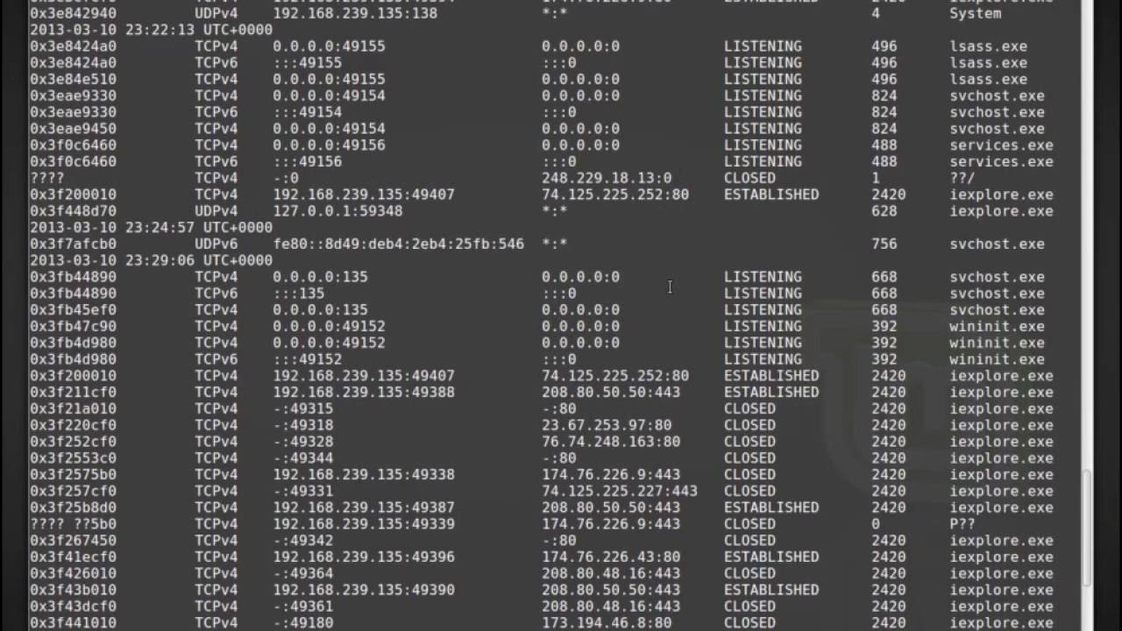
Memory Forensics
Analyzing a system based on a RAM snapshot
Volatile memory - provides a moment in time
Only focuses on what’s running
Geared towards malware analysis
Preserves network connections and processes
Volatility framework

